Slide 1
PLANING , ANALYSIS AND DESIGN OF G+3
RESIDENTIAL BUILDING

Slide 2
ABSTRACT
In this project we have planned, analyzed and designed a G+3
Residential building. For this Requirement a G+3 residential
Building is planned using the popular drafting software AUTO
CAD 2D. It is further analyzed using the premier analysis
software STADD PRO. Then by using REVIT the 3D view
Of the building is obtained based on the analysis of STADD PRO
The salient features of the G+3 residential building is manually
designed the design and detailed drawing are represented in
This project work.

Slide 3
OBJECTIVE :
To make a complete design of the main structural
elements of a residential building with the
sustainable bio tank .
The design is based on sustainable ideas.

Slide 4
METHODOLOGY
Plan Preparation or Schedules of drawings
Design / Development
Analysis and Optimizations
Final check out and Report making
Conclusion

Slide 5
PROJECT DETAILS
Building area : 24x13.21m
Area location : Coimbatore , Tamil Nadu
Purpose of building : RESIDENTIAL BUILDING
No of stories : G +3
Height of each story : 3 m
- Shape of the building : Rectangular
- Grade of concrete : M25
- Grade of steel : Fe 415

Slide 6
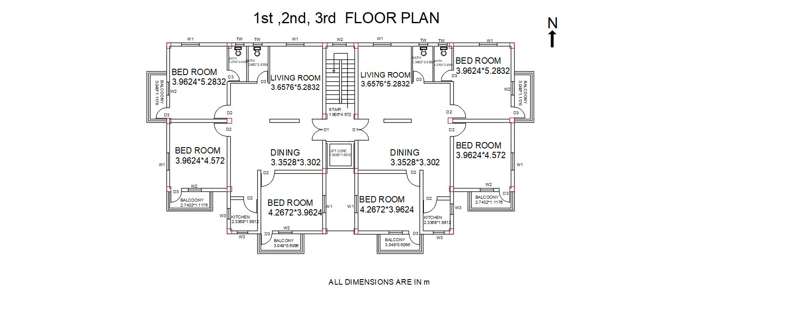
AUTO CADD DRAWING

Slide 7
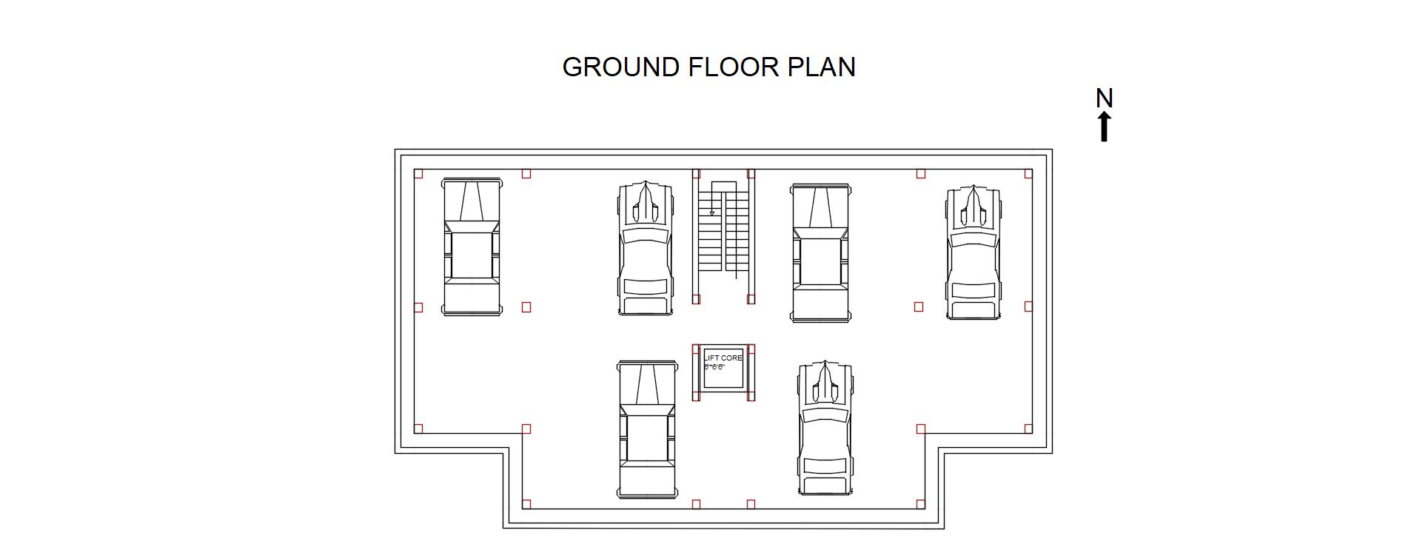
AUTO CADD DRAWING

Slide 8
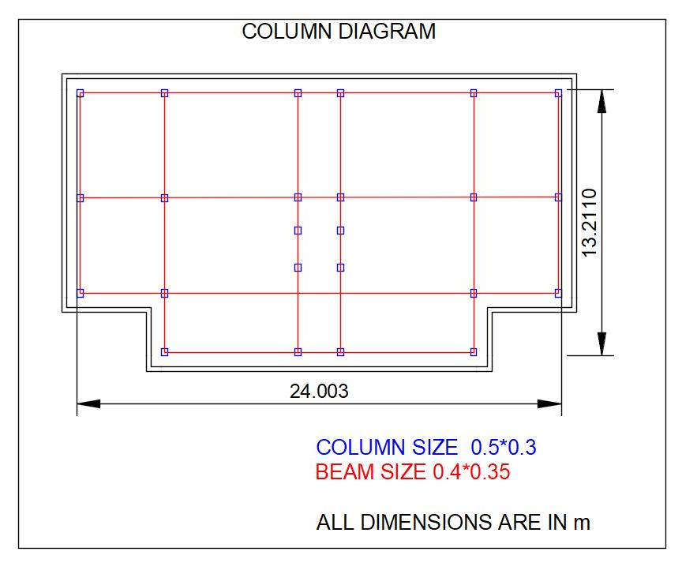
STRUCTURAL AND CENTRE LINE PLAN DRAWING

Slide 9
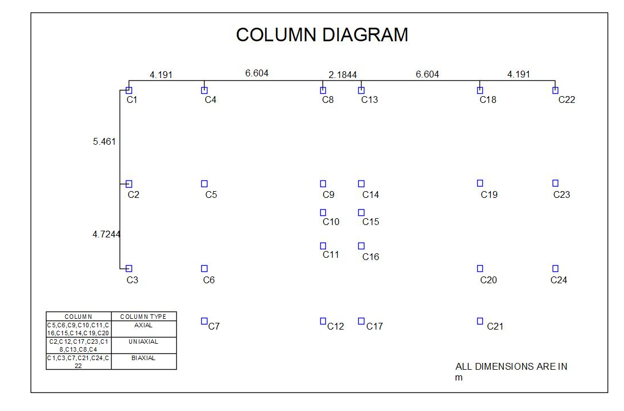
COLUMN LAYOUT

Slide 10
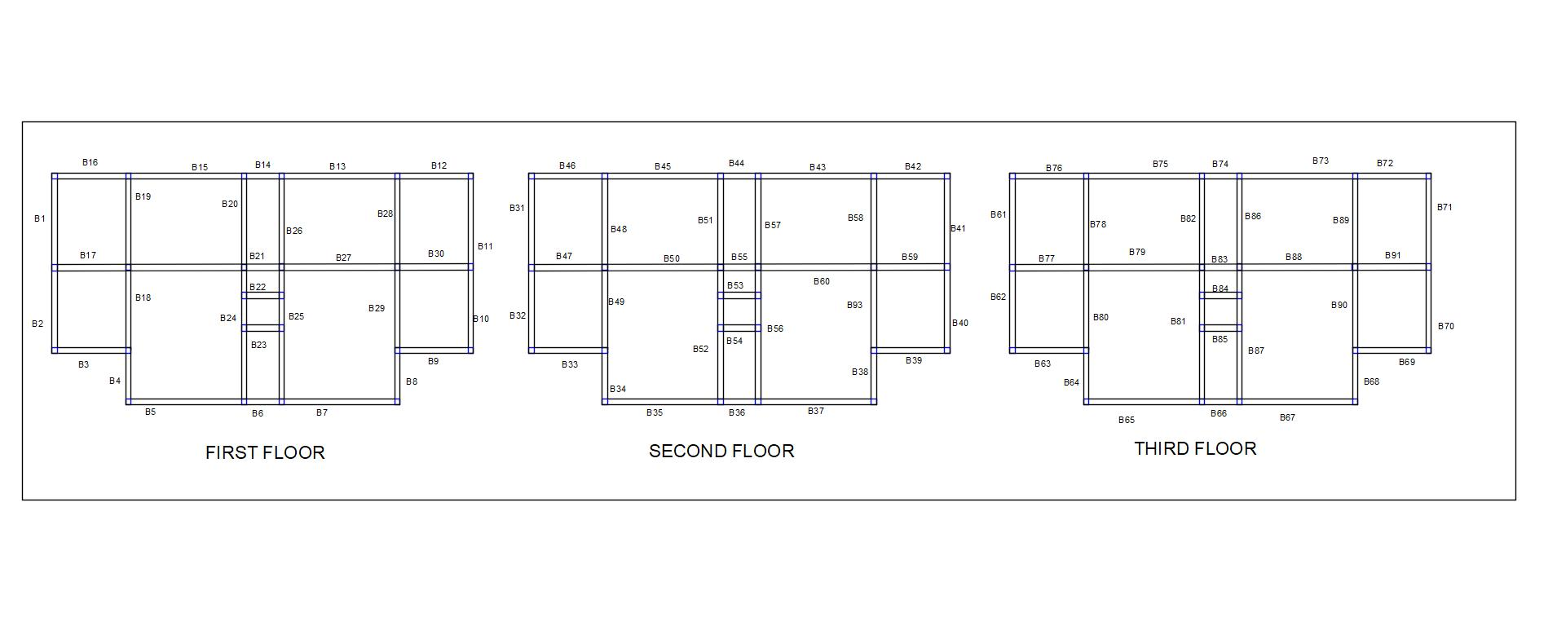
BEAM LAYOUT

Slide 11
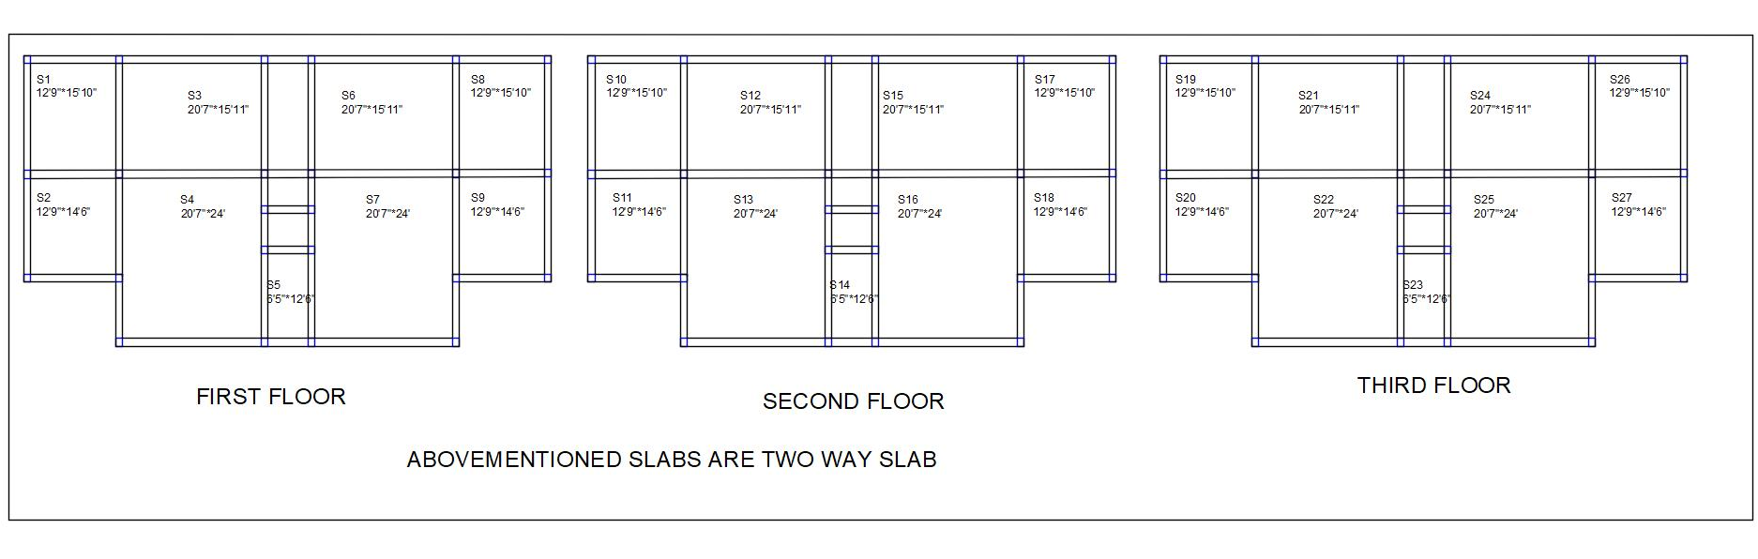
SLAB LAYOUT

Slide 12
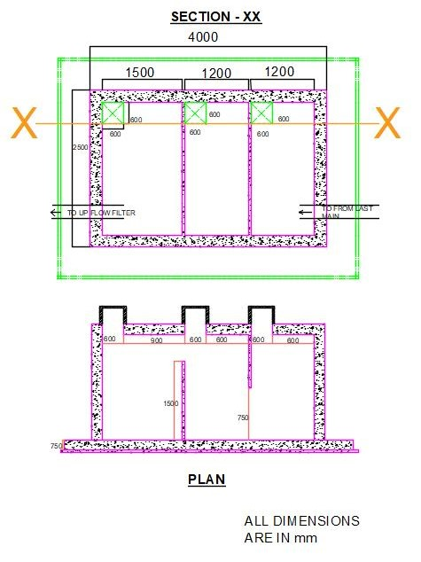
BIO SEPTIC TANK

Slide 13
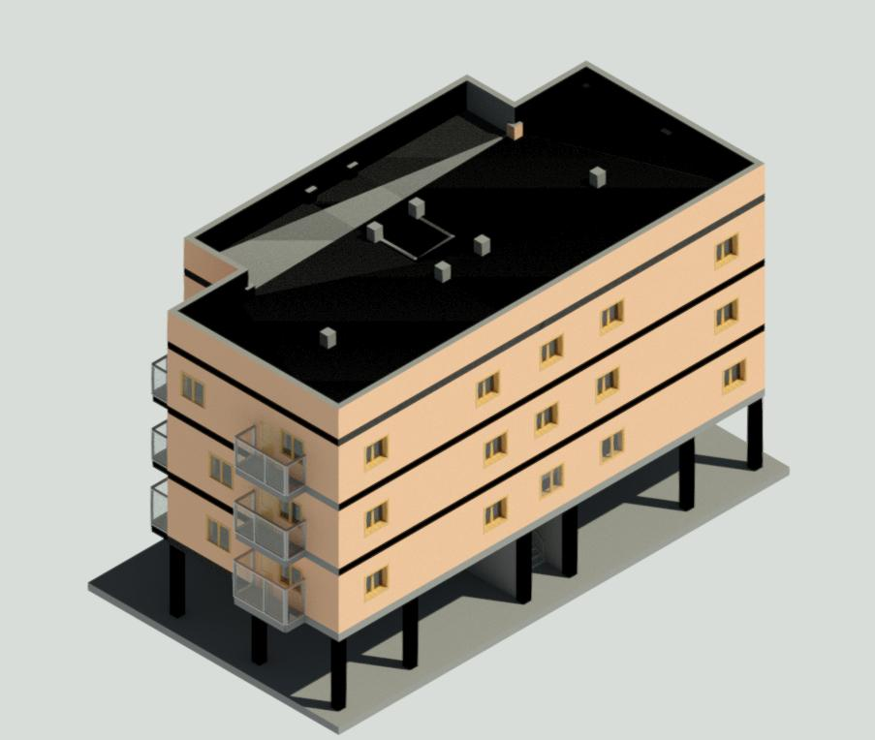
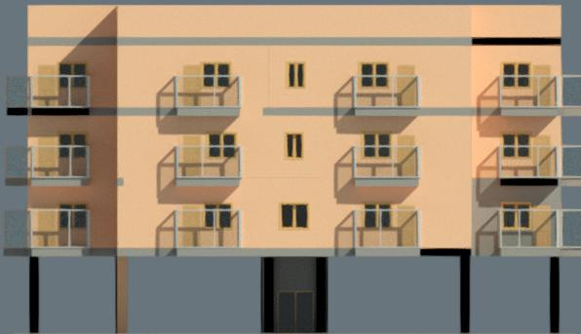
3D MODELLING
FRONT VIEW

Slide 14
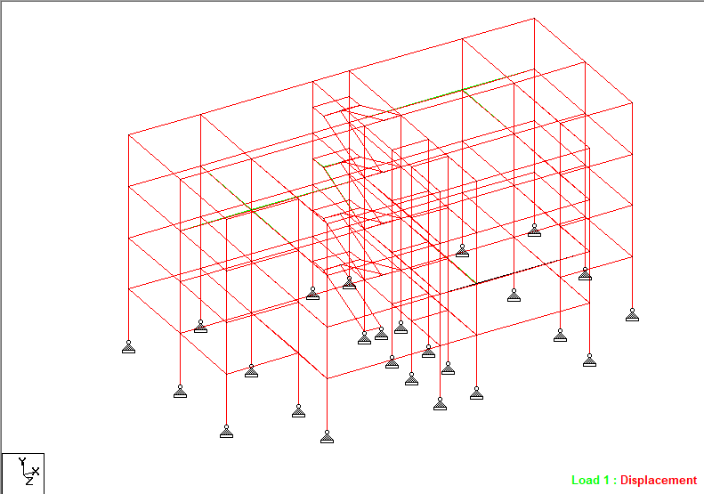
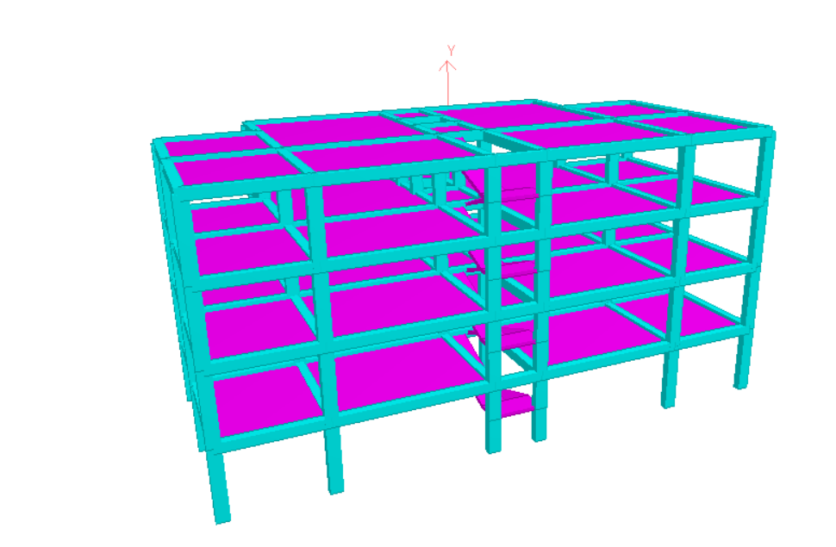
ANALYSIS RESULTS 3-D VIEW

Slide 15
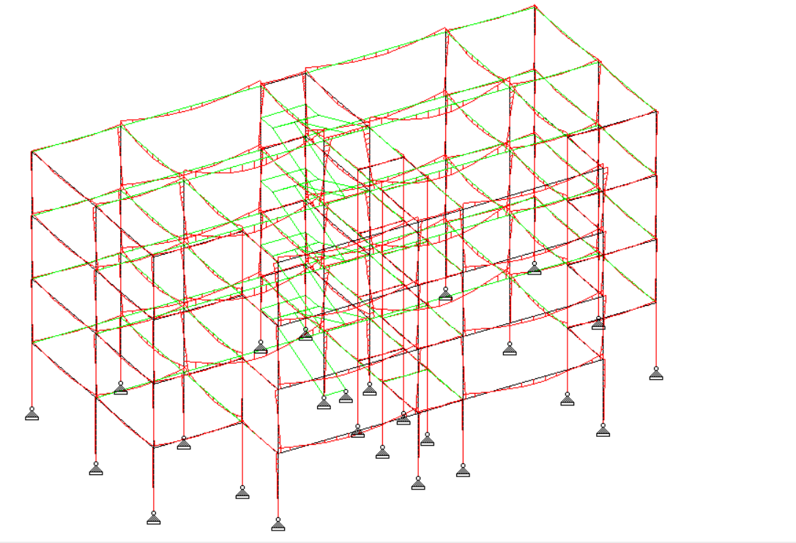
BENDING MOMENT DIAGRAM

Slide 16
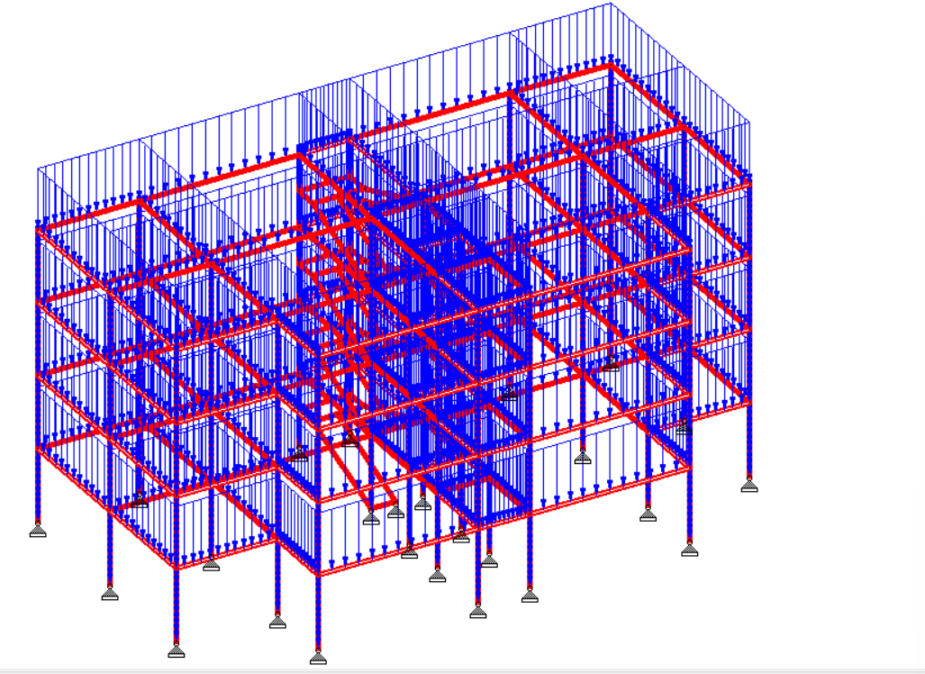
APPLIED DEAD LOADS

Slide 17
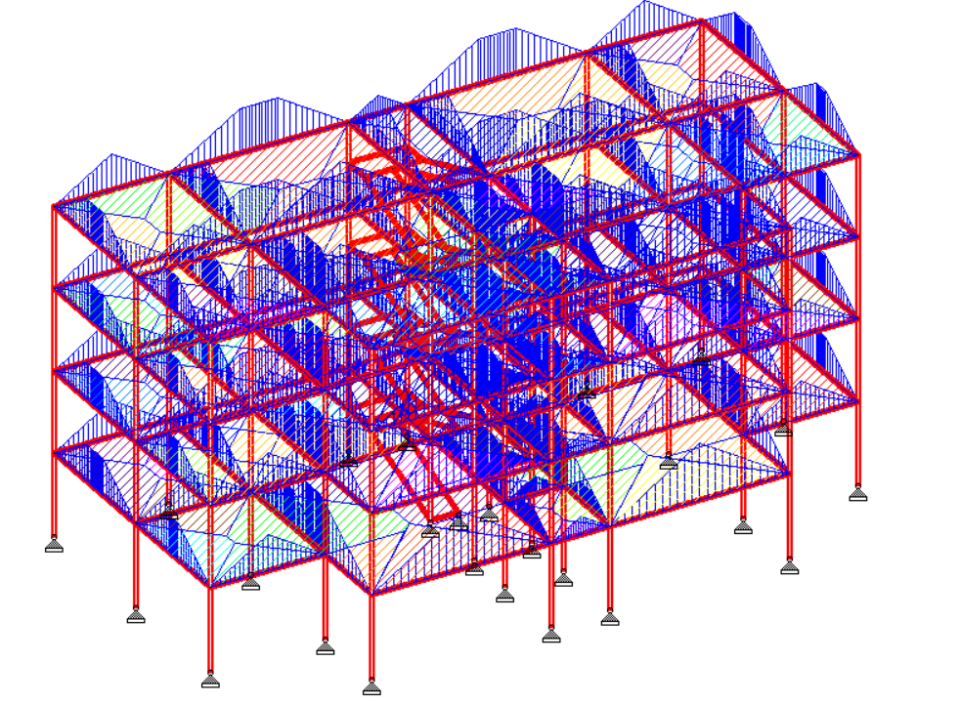
APLLIED LIVE LOADS

Slide 18
Design of Two Way Slab
SLAB NUMBER : 120
Size of slab = 6.59 m X 5.18 m
Effective depth, d = 200mm
Overall depth, D = 220mm
Factored load, Wu = 29.625 kN/m
Moment, Mux = 73.40 kNm
Moment, Muy = 76.366 kNm
Reinforcement details
A_{st}=1171mm² along x direction [M_{u} = 0.87 f_{y}A_{st} d [1-((A_{st}f_{y})/(f_{ck} b d))]
-Along shorter span (x-direction), reinforcement provided is of 16mm dia bar at 200mm c-c spacing
A_{st}= 1120.6mm² along y direction [M_{u} = 0.87 f_{y}A_{st} d [1-((A_{st}f_{y})/(f_{ck} b d))]
-Along longer span (y-direction), reinforcement provided is of 16mm dia bar at 200 mm c-c spacing
Check for deflection
(L/d)max=( L/d)basic x kt x kc x kf =36.4
(L/d)actual = 5180 / 200 = 25.9
(L/d)max > (L/d)actual , Hence slab is safe in deflection.

Slide 19
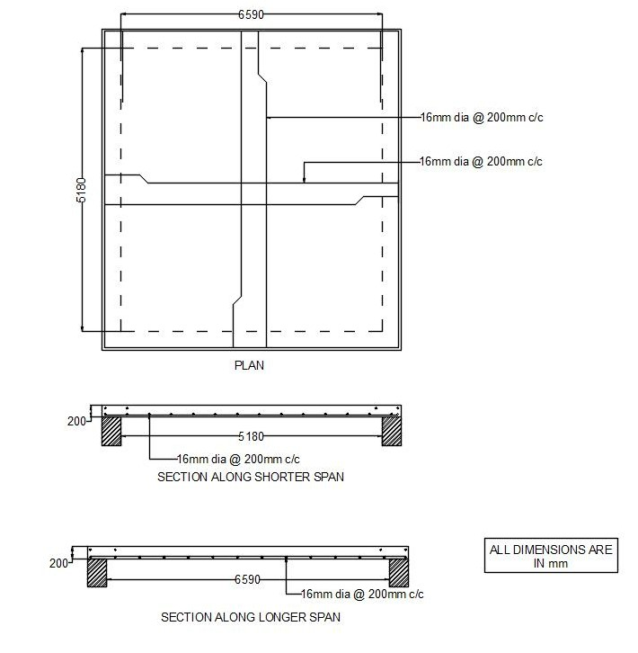
REINFORCEMENT OF SLAB

Slide 20
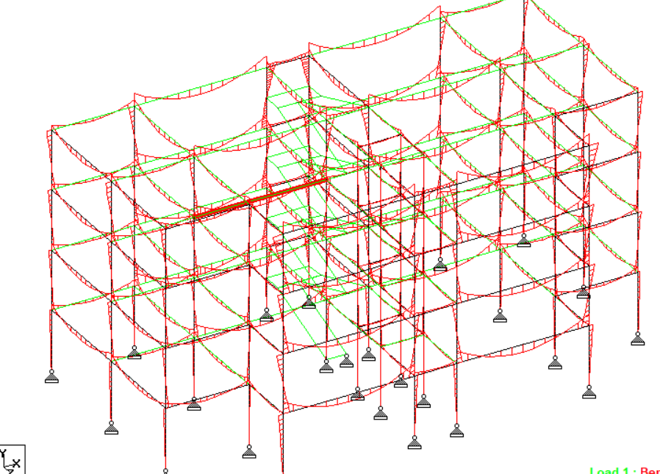
ANALYSIS RESULTS
CRITICAL BEAM
BEAM NO: 174

Slide 21
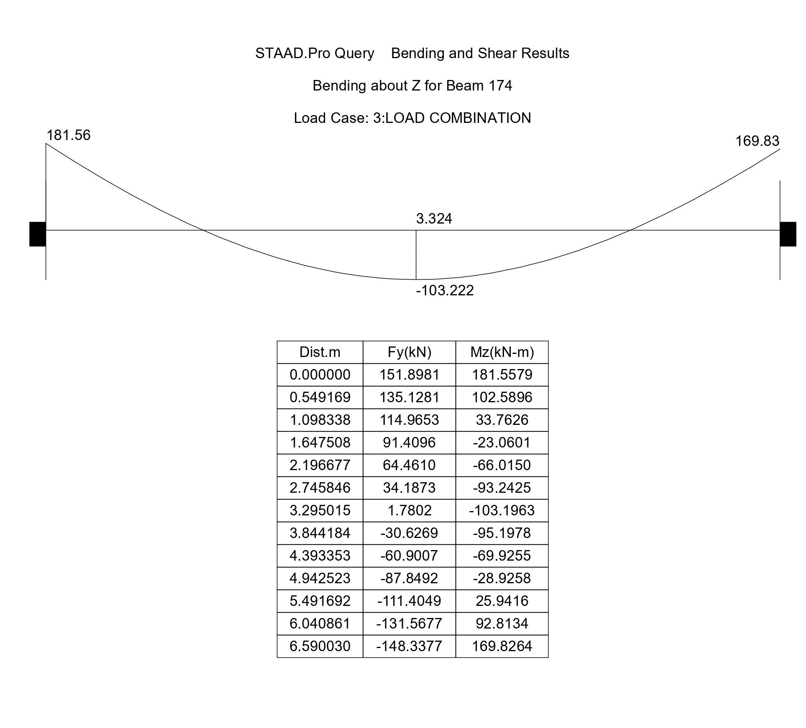
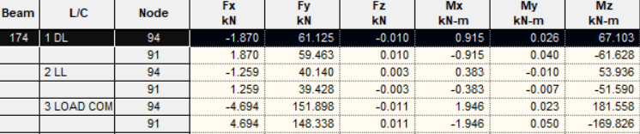
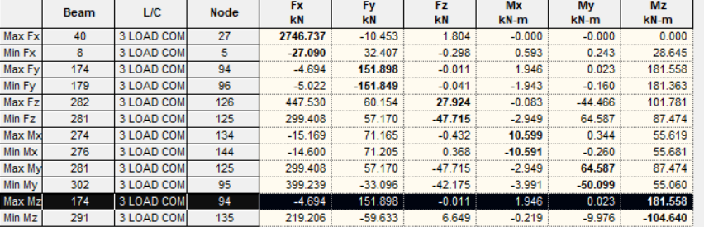
From STADD PRO

Slide 22
DESIGN OF BEAM
Size of Beam = 350mm X 400mm
Effective span = 6590mm
Effective depth, d = 370mm
Factored moment, Mu(-) = 181.56kNm
Factored moment, Mu(+) = 103.19kNm
M_{U} limit = 193 kN/m (M_{U} limit = 0.138 f_{ck}*bd²)
M_{U}< M_{u} limit
The beam has to be designed for singly reinforced beam
A_{st}= 1751mm² [M_{u} = 0.87 f_{y}A_{st} d [1-((A_{st}f_{y})/(f_{ck} b d))]
Negative reinforcement
-Provide 6 nos of 20 mm dia at the top tension face near supports.
A_{st}= 868.1mm² [M_{u} = 0.87 f_{y}A_{st} d [1-((A_{st}f_{y})/(f_{ck} b d))]
Positive reinforcement at midspan
-provide 4 nos of 20 mm dia at bottom tension at center span section

Slide 23
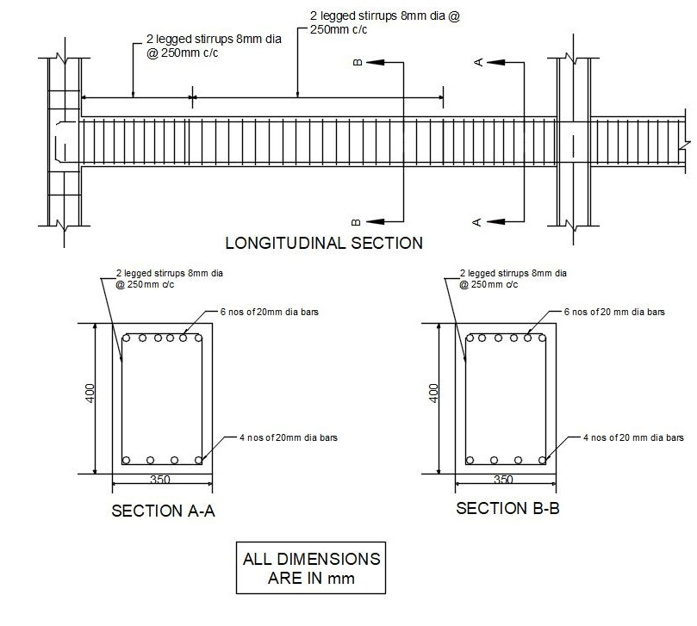
REINFORCEMENT OF BEAM

Slide 24
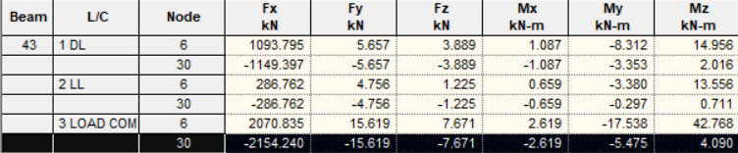
VALUE FROM STADD PRO
Muz : 105.21 Muy : 59.13

Slide 25
DESIGN OF COLUMN SUBJECTED TO UNIAXIAL BENDING
Size of column = 300mm X 500mm
Effective span =3000mm
Effective length, L _{eff} =2100mm
Factored load, Pu = 2154kN
Factored moment, M_{UX}=108.21kNm
M_{UY}=59.13kNm
Equivalent moment = 1.15 √(M_{ux2} + M_{uy2}) =141.8kNm
Longitudinal reinforcement
-Provide 10 nos of 20mm bar which is equally distributed on two Sides
A_{st} provided =3000mm² (P_{uz} = 0.45f_{ck}*A_{sc}+0.75f_{y}A_{sc} )
Lateral ties
-provide 8 dia bar of lateral ties at 250 mm spacing

Slide 26
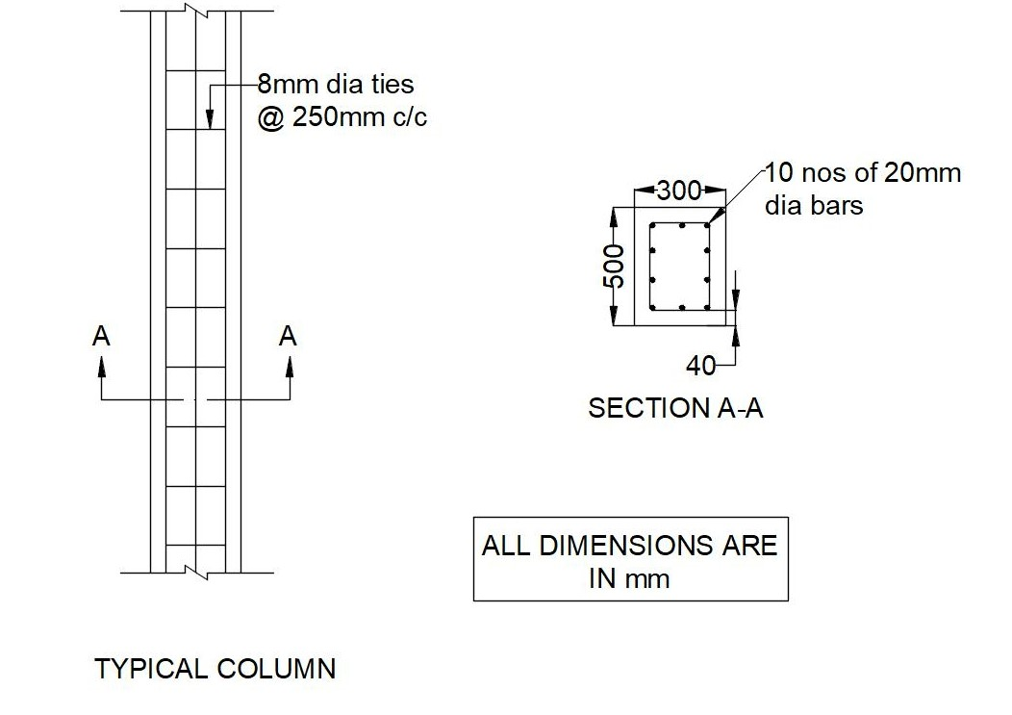
REINFORCEMENT OF COLUMN

Slide 27
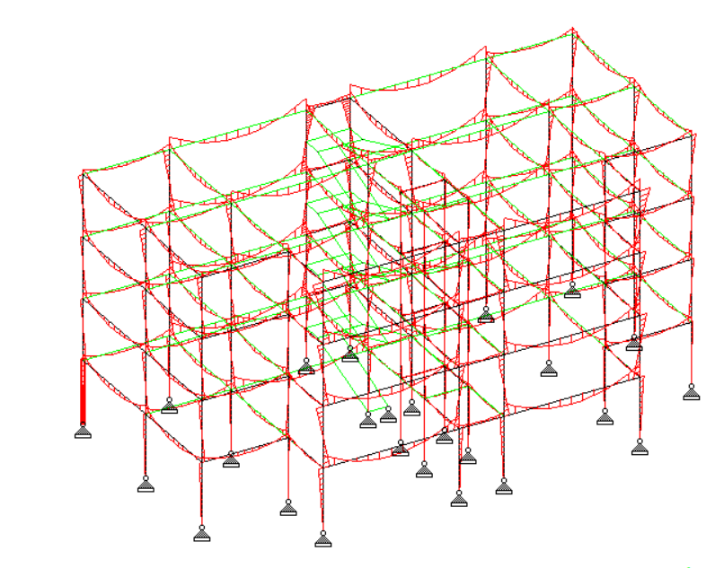
COLUMN SUBJECTED TO BIAXIAL BENDING

Slide 28
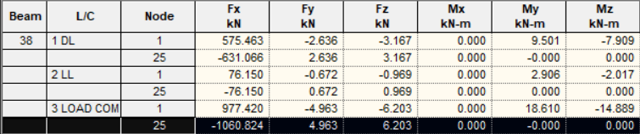

Slide 29
DESIGN OF COLUMN SUBJECTED TO BIAXIAL BENDING
Size of column = 300mm X 500mm
Effective span = 3000mm
Effective length, El = 2100mm
Factored load, Pu = 1060 kN
Factored Moment , M_{UX} = 133kNm
M_{UY} = 75.5 kNm
Equivalent moment = 1.15 √(M_{ux2} + M_{uy2}) = 175.5kNm
Longitudinal reinforcement
-Provide 8 nos of 20mm bar which is equally distributed on two sides
A_{st} provided = 2512mm² (P_{uz} = 0.45f_{ck} xA_{sc}+0.75f_{y}A_{sc} )
Lateral ties
-provide 8 dia bar of lateral ties at 250 mm spacing

Slide 30
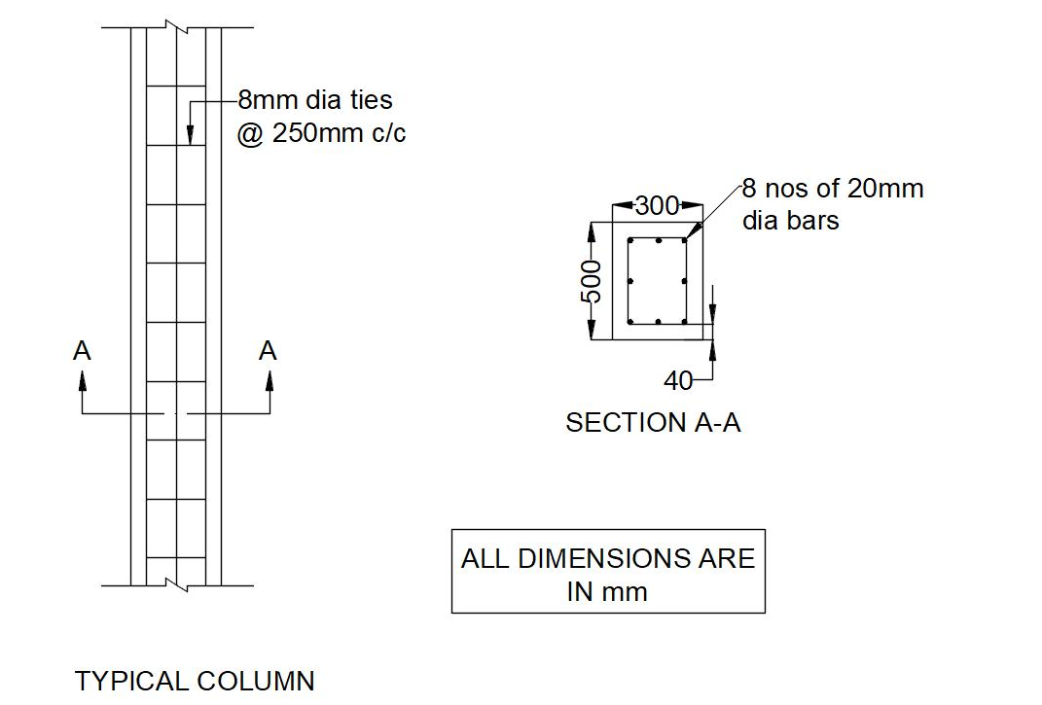
REINFORCEMENT OF COLUMN

Slide 31
DESIGN OF STAIR CASE
Size of staircase = 2.1*4.5 m
Rise = 150mm
Thread = 280mm
No of flight = 2
Width of the flights = 950mm
Width of the landing = 2050mm
Effective depth = 230mm
Overall depth = 250mm
Total load on Landing = 9 kN/m
Total load on waist portion = 12.125kN/m
M_{U} = 45 kNm ,(M_{U} = 0.138fckbd²)
A_{st} =575mm² [M_{u} = 0.87 f_{y}A_{st} d [1-((A_{st}f_{y})/(f_{ck} b d))]
Main Reinforcement
-Use 12mm dia bar req for each flight @ 200mm spacing
Distribution Reinforcement, A_{st}= 276mm²
-Use 8 mm dia bar @ spacing 180mm

Slide 32
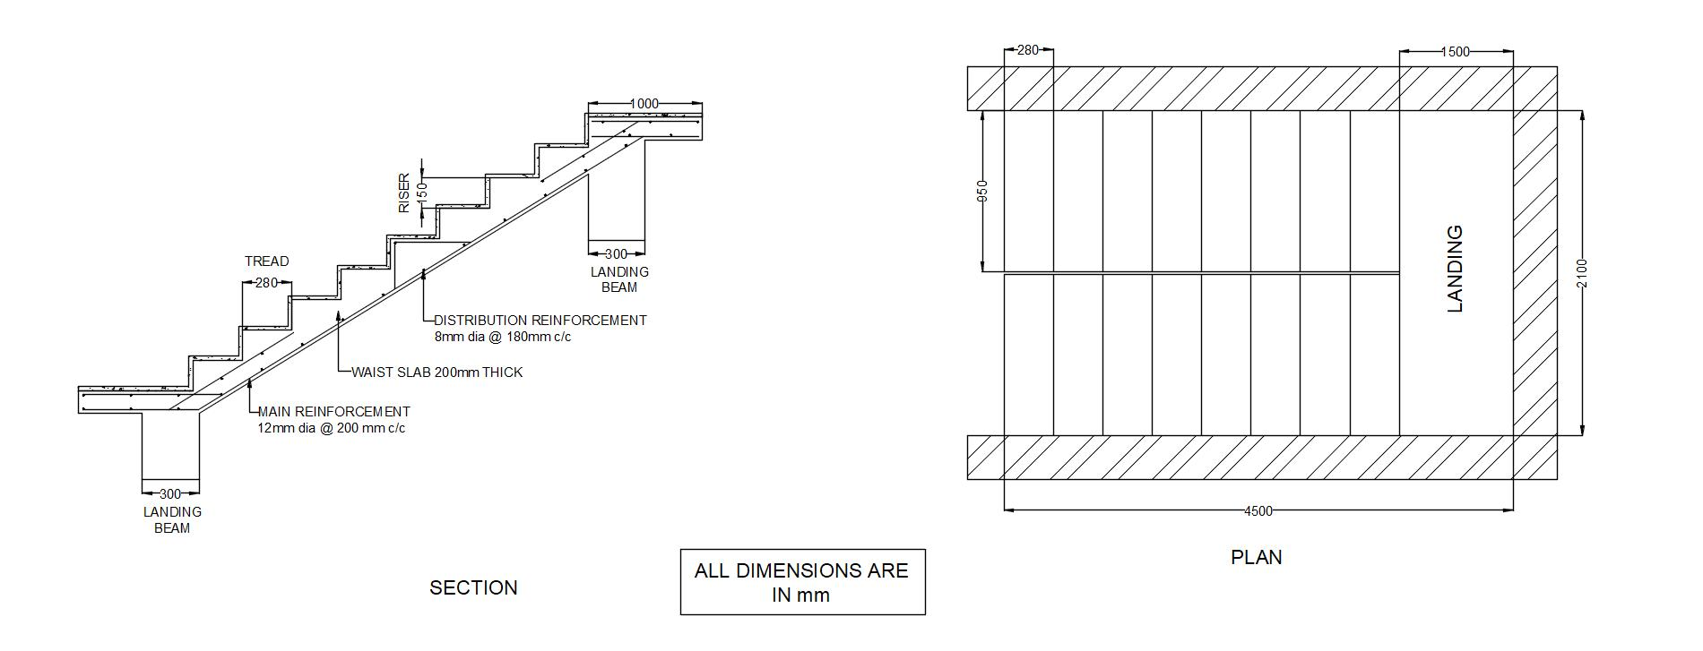
REINFORCEMENT OF STAIR CASE

Slide 33
DESIGN OF FOOTING
Size of footing = 2.48 *1.55m
Overall depth,D = 600mm
Effective depth,d = 550mm
Main Reinforcement
Along xx, A_{st} =1011.17mm² [M_{u} = 0.87 f_{y}A_{st} d [1-((A_{st}f_{y})/(f_{ck} b d))]
-Provide 8 nos of 16 mm dia bar which is equally distributed
Along yy, A_{st} = 1617.8 mm² [M_{u} = 0.87 f_{y}A_{st} d [1-((A_{st}f_{y})/(f_{ck} b d))]
-Provide 5 nos of 16 mm dia bar which is equally distributed
Check for shear τ_{c}= 0.92N/mm², τ_{v} =0.33N/mm²
τ_{v}<τ_{c}
Check for two way shear, τ_{c} =1.25N/mm², τ_{v} =0.56N/mm²
τ_{v}<τ_{c}

Slide 34
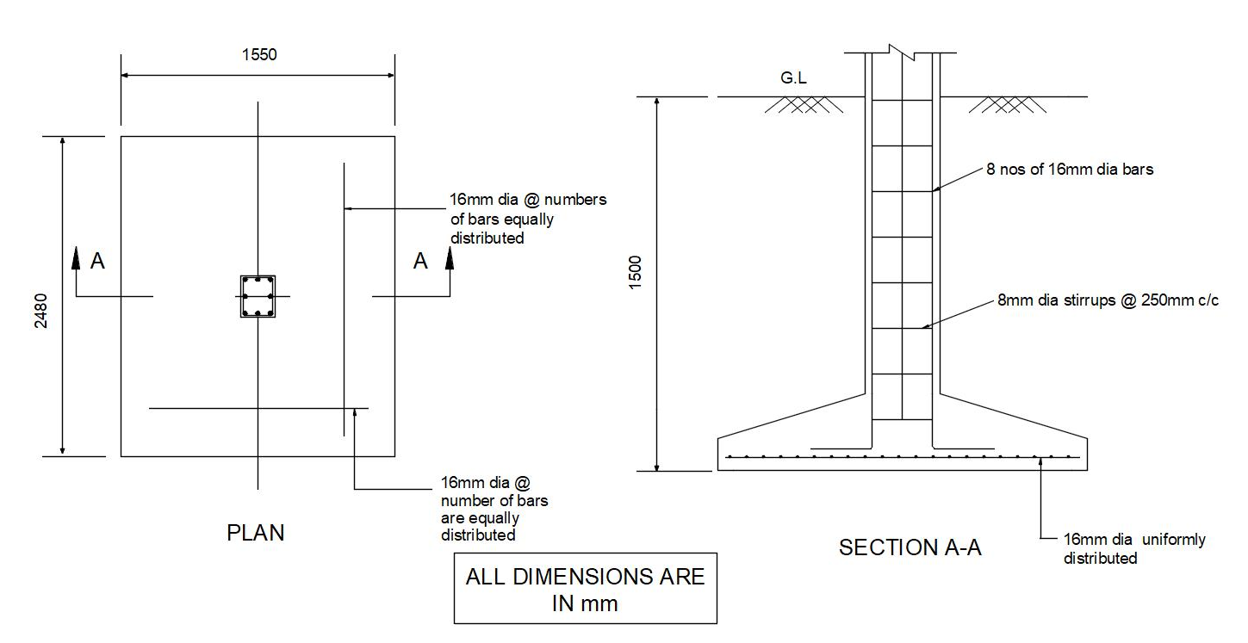
REINFORCEMENT OF FOOTING

Slide 35
BIO SEPTIC TANK

Slide 36
DESIGN OF SEPTIC TANK
No of users : 50
The quantity of water supplied=per capita rate *population
Total required capacity of the tank =capacity for sewage + capacity of sludge
Tank size : 4 * 2.5 m
Qwet = 6° Qdry = 30° Wsoil = 20n/m 3
Overall depth = 230 mm
Effective depth = 200
Total load =7.25kN/m
Factored Load = 11kN/m
A_{st} =1232.41mm² (wall), A_{st} = 395mm² (roof slab) [M_{u} = 0.87 f_{y}A_{st} d [1-((A_{st}f_{y})/(f_{ck} b d))]
Main reinforcement for base slab , roof slab ,near face and away face water
-Provide 12 mm bars @ 120 mm c/c
Distribution bars for base slab , roof slab ,near face and away face water
Distribution =0.3% of b *d
-Provide 10 mm bars @ 120 mm c/c

Slide 37
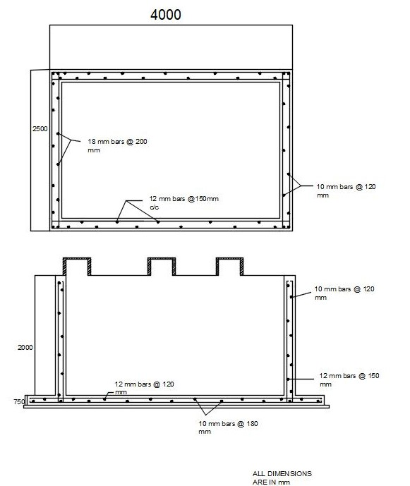
REINFORCEMENT OF SEPTIC TANK
ALL DIMENSIONS ARE IN mm

Slide 38
CONCLUSION
Thus the structure has been planned using AUTOCADD software . It has been
Analyzed using STADD PRO.
This project gave us practical knowledge about how to design a building and its
elements as per code book.

Slide 39
Referred Indian standard codes:
IS-456, Plain and reinforced Concrete-Code of Practice, Bureau of Indian Standards, New Delhi,2000.
IS 875, Code of Practice for Design Loads (Other than Earthquake) for Buildings and Structures- Part 2Imposed Loads, (Second Revision), Bureau of Indian Standards, New Delhi,1987.
SP 16 - 1980 ,Design Aids for Reinforced Concrete to IS:456 - 1978 , Bureau of Indian Standard
New Delhi

Slide 40
THANK YOU

